Slide 1

Welcome
Notes:
Topic: Goal Setting
Time: 30 minutes
Purpose of training evolution: This training equips Sailors with a roadmap for continuous improvement by establishing, implementing, and reviewing goals to reinforce desired behaviors and track progress.
Expected outcome of training evolution: Sailors will set, implement, and track goals to drive continuous improvement and reinforce desired behaviors.
Safety: Inform Sailors of safety hazards in the training environment. For some topics, Sailors should be informed if there is a designated person to talk to if the Sailor feels compelled to leave the training.
Facilitator Actions:
Display slide.
Greet Sailors.
Introduce yourself and give any background on yourself that might be of interest.
Establish credibility.
Facilitator Instructions:
The slide deck acts as a guide to present a facilitated discussion that may include activities.
Best practice: Use the slide to develop interest in the subject matter. Do not read the slides word for word. The Sailors should be able read the text and understand the messaging presented in the graphics.
Facilitator notes are available for each slide to help the Facilitator deliver the topic.
Best practice: Use the Slide Show view to ensure the Facilitator notes are viewable.
The Facilitator notes are divided into general instructions for Facilitator Actions (mechanics of facilitation) and the Facilitator Content (Inform, Discuss, Perform, and Reference).
Best practice for Inform: Present facts, concepts, and procedures. Depending on the subject matter, these may be written as suggested talking points or scripted material (denoted by quotation marks).
Best practice for Discuss: Conduct large-group question and answer sessions or large-group, Facilitator-led activities. Depending on the subject matter, these may be written as questions with expected answers or scripted activities.
Best practice for Perform: Facilitate small-group, scenario-based or procedural activities. Depending on the subject matter, these may be written with specific actions the Sailors will take or general ways for the Facilitator to monitor the activities. The Facilitator will be provided with expected outcomes to ensure Sailors leave training with correct information.
Best practice for Reference: This is for Facilitator use only.

Slide 2
Introduction
Warrior Toughness
MIND • BODY • SPIRIT
Goal Setting
Notes:
Facilitator Actions:
Display slide.
Introduce topic.
Let Sailors know that they can leave the discussion if they have to for their own well-being.
Ensure that misinformation is corrected immediately.
Monitor the discussions of the Sailors throughout the training event.
Facilitator Content:
To build Warrior Toughness, Sailors will explore Warrior Toughness and the Warrior Mindset and participate in discussions to enable Sailors to develop their why (warrior ethos).

Slide 3
Learning Objective
Use goal setting to gain direction and focus to achieve desired behaviors.
Notes:
Facilitator Actions:
Display slide.
Neither Sailors nor Facilitator should read the objective out loud.
Facilitator Content: N/A

Slide 4
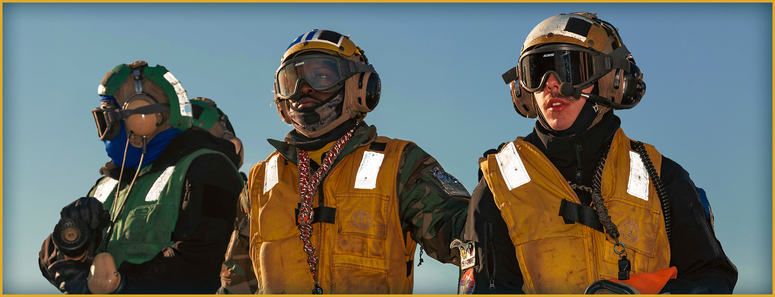
Self-Confidence
Why might having self-confidence be important?
Notes:
Facilitator Actions:
Display slide.
Discuss how graphic relates to topic.
Monitor the discussions of the Sailors.
Facilitator Content:
Inform:
Self-confidence is the trust people have in their own skills and abilities.
Discuss:
Ask the Sailors, “Why might having self-confidence be important?”
Inform:
Self-confidence and performance are intertwined.
The higher our self-confidence, the better we perform.
The lower our self-confidence, the worse we perform.
The better we perform, the more our self-confidence grows and vice versa.

Slide 5

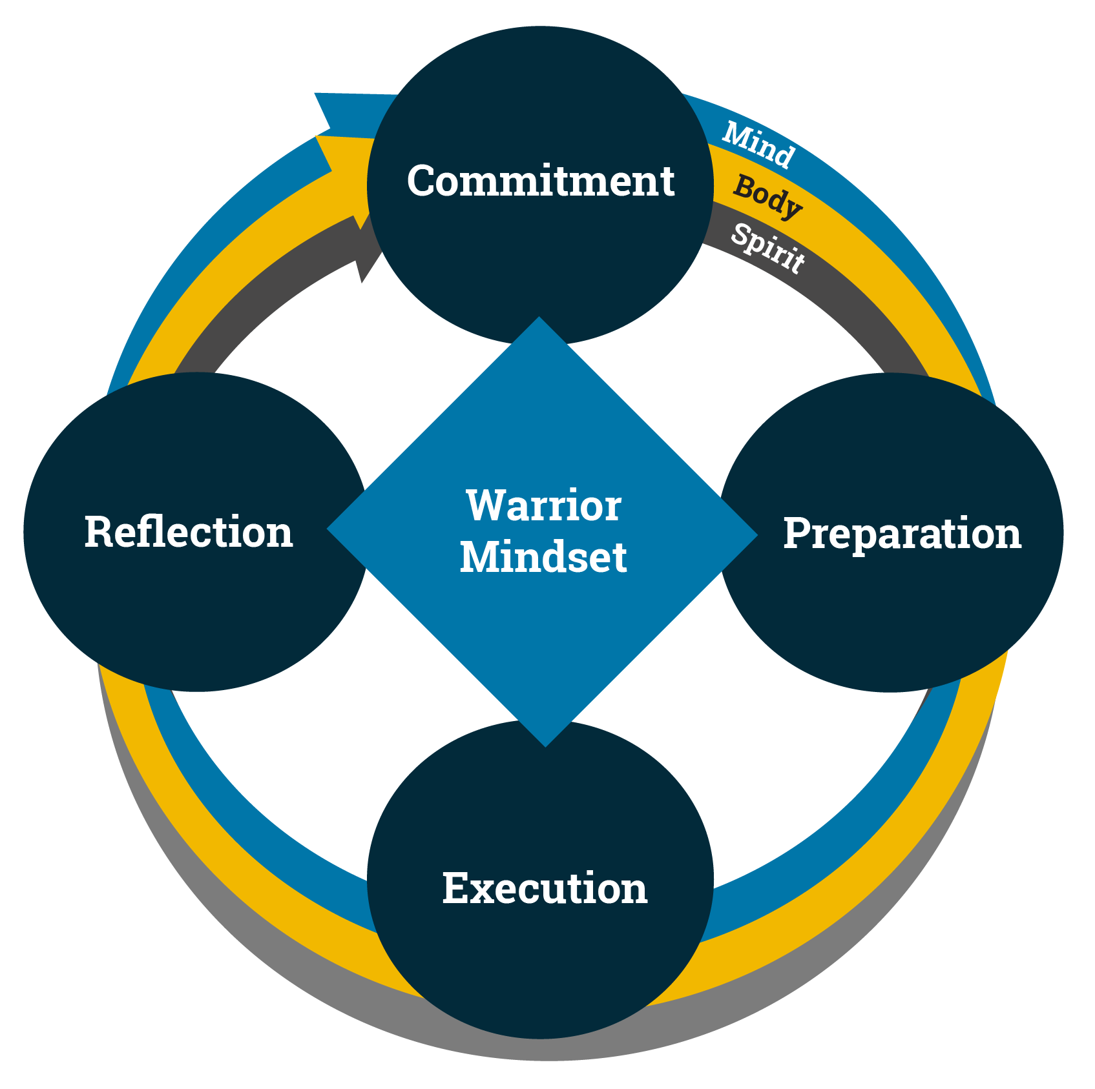
Confident People
How might strengthening our Warrior Mindset help us to build our self-confidence?
Notes:
Facilitator Actions:
Display slide.
Discuss how graphic relates to topic.
Monitor the discussions of the Sailors.
Facilitator Content:
Inform:
Confident people are committed. They know what is important to them and set their goals accordingly.
People with self-confidence prepare and execute their goals by using positive self-talk. They do their best to achieve their goals by interpreting nervousness as excitement.
Confident individuals execute reflection in healthy ways. They enjoy their success and review failures as learning opportunities.
Discuss:
Ask the Sailors, “How might strengthening our Warrior Mindset help us to build our self-confidence?”

Slide 6

Goals
Goals influence our:
Efforts
Decisions
Emotions
Behaviors
Notes:
Facilitator Actions:
Display slide.
Discuss how graphic relates to topic.
Monitor the discussions of the Sailors.
Facilitator Content:
Inform:
Goals are our self-talk. They are our ideas about what we want to accomplish in the future.
Goals influence our:
Efforts
Decisions
Emotions
Behaviors

Slide 7
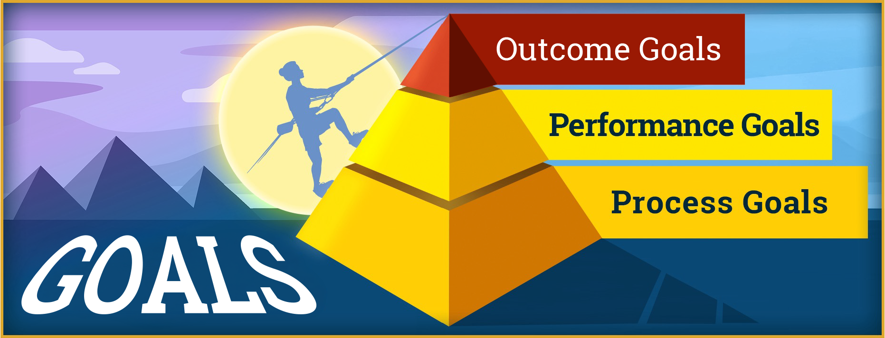
Goals: Types
Notes:
Facilitator Actions:
Display slide.
Discuss how graphic relates to topic.
Monitor the discussions of the Sailors.
Facilitator Content:
Inform:
To successfully achieve our desired outcomes, we need to categorize our goals into three levels.
Outcome goals are overarching goals. They may be difficult to measure or know when we achieve them.
Example: Live our lives IAW the Sailor’s Creed.
Performance goals are the intermediary goals that we undertake to reach our outcome goals. We can think of them as the checkpoints we have toward reaching our overarching goals.
Example: Successfully complete Officer Candidate School (OCS).
Process goals are the steps that we take on a regular basis to achieve our performance goals.
Example: Practice 12 minutes of mindfulness training, 3 times per week.
Discuss:
Ask the Sailors, “If I tell you that my performance goal is to complete OCS, what may be missing from this performance goal statement?”

Slide 8

Goals: SMART
Notes:
Facilitator Actions:
Display slide.
Discuss how graphic relates to topic.
Monitor the discussions of the Sailors.
Facilitator Content:
Inform:
At the performance and process goal levels, we are much more likely to attain these goals if they are SMART.
Specific:
The goal must be detailed enough that we know what actions we need to take, when we should perform them, why we are performing them, and how we will perform those actions.
Measurable:
Our goal must have a measurable outcome.
Attainable:
Our desired outcome, and the steps we need to take to accomplish our goal, must be both challenging and realistic.
Relevant:
It is imperative that our goal be personally meaningful and relate back to our outcome goals.
Timely:
Our goal must be time-bound, with a start point and an end point.
Discuss:
Lead a 3-minute group discussion: How could we reword my performance goal to complete OCS as a SMART goal?
Answers may include:
Outcome: I want to successfully complete OCS within the next 12 weeks.
Performance: By week 9 of OCS, I need to be able to jump into the pool from a 10-foot tower without hesitation, remain afloat face down for 5 minutes, use my coverall as a floatation device, and swim 50 yards in under a minute.
Process: For the next 11 weekends, I will spend 3 hours each Saturday and Sunday practicing the 10-foot tower jump, remain afloat for 6 minutes in a prone position, create a floatation device out of my coverall and remain afloat for 10 minutes, practice completing the sidestroke 50-yard swim in 50 seconds, and record my progress at the end of each training session.
Perform:
Instruct each Sailor to partner with another Sailor and formulate one SMART performance goal and process goal per Sailor (four SMART goals per group of two Sailors).
Allow 10 minutes for this activity.
At the end of the 10 minutes, each Sailor should have one SMART performance goal and one SMART process goal. Ask Sailors to come back together as a group and ask if any Sailor would like to share their SMART goals.
Allow 2 minutes for Sailor responses.

Slide 9

Goals: Barriers
What are some difficulties that we may run into when setting or working on our goals?
Notes:
Facilitator Actions:
Display slide.
Discuss how graphic relates to topic.
Monitor the discussions of the Sailors.
Facilitator Content:
Discuss:
Ask the Sailors, “What are some difficulties that we may run into when setting or working on our goals?”
Inform:
One of the barriers we may run into while in pursuit of our goals is setting too many goals at once.
Overcome by prioritizing what is truly important to us.
Another obstacle may be that we have too many conflicting priorities.
Circle back to your commitment by being realistic with your time and energy.
We may have goals that have been set for us that we feel like we cannot take ownership of.
Make the goals our own by tying them back into our Warrior Mindset.

Slide 10
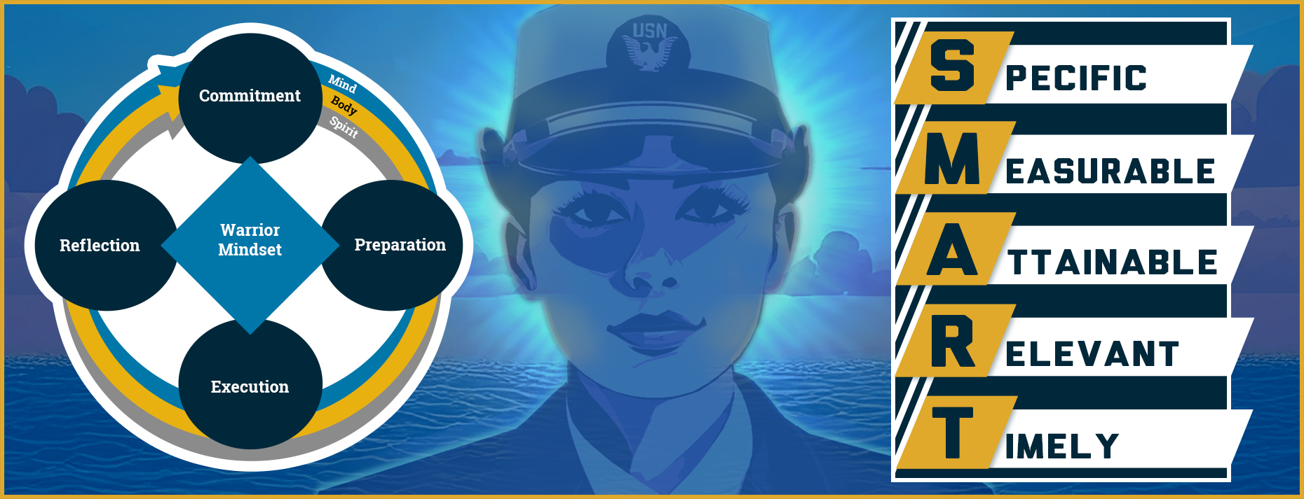
Goals: Warrior Mindset
What are some examples of how our SMART goals tie back into the Warrior Mindset?
Notes:
Facilitator Actions:
Display slide.
Discuss how graphic relates to topic.
Monitor the discussions of the Sailors.
Facilitator Content:
Inform:
The Warrior Mindset is a cycle of excellence that requires continuous improvement and alignment of our actions with our values.
Discuss:
Lead a 3-minute discussion: What are some examples of how our SMART goals tie back into the Warrior Mindset?

Slide 11

Call to Action
Set goals to build Warrior Toughness!
Notes:
Facilitator Actions:
Display slide.
Review topics discussed and ask if there are any questions.
Check Sailor comprehension by providing review questions and/or problems.
Discuss how the call to action supports and encourages Sailors’ post training.
Relate call to action to Warrior Toughness.
Facilitator Content: N/A

Slide 12
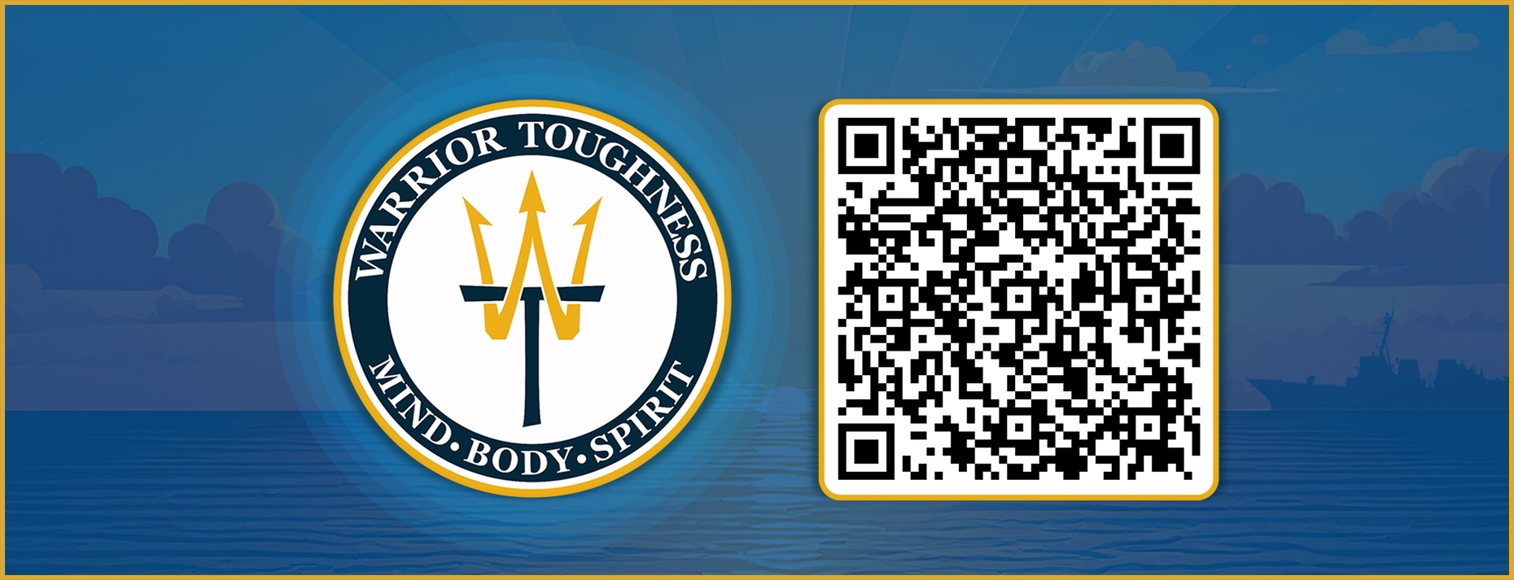
Warrior Toughness QR Code
Notes:
Facilitator Actions:
Display slide.
Facilitator Content:
Inform:
Identify Warrior Toughness QR code.

Slide 13
References
Tools and Resources
MyNavy HR, Warrior Toughness
Warrior Toughness Placemat
Notes:
Facilitator Actions:
Display slide.
Facilitator Content:
Inform:
Identify tools.
Identify resources.

Slide 14
Glossary
Glossary
Acronym | Term
OCS | Officer Candidate School
SMART | Specific, Measurable, Attainable, Relevant, and Timely
WT | Warrior Toughness
Notes:
Facilitator Actions:
Display slide.
Facilitator Content: N/A

